Slide 1
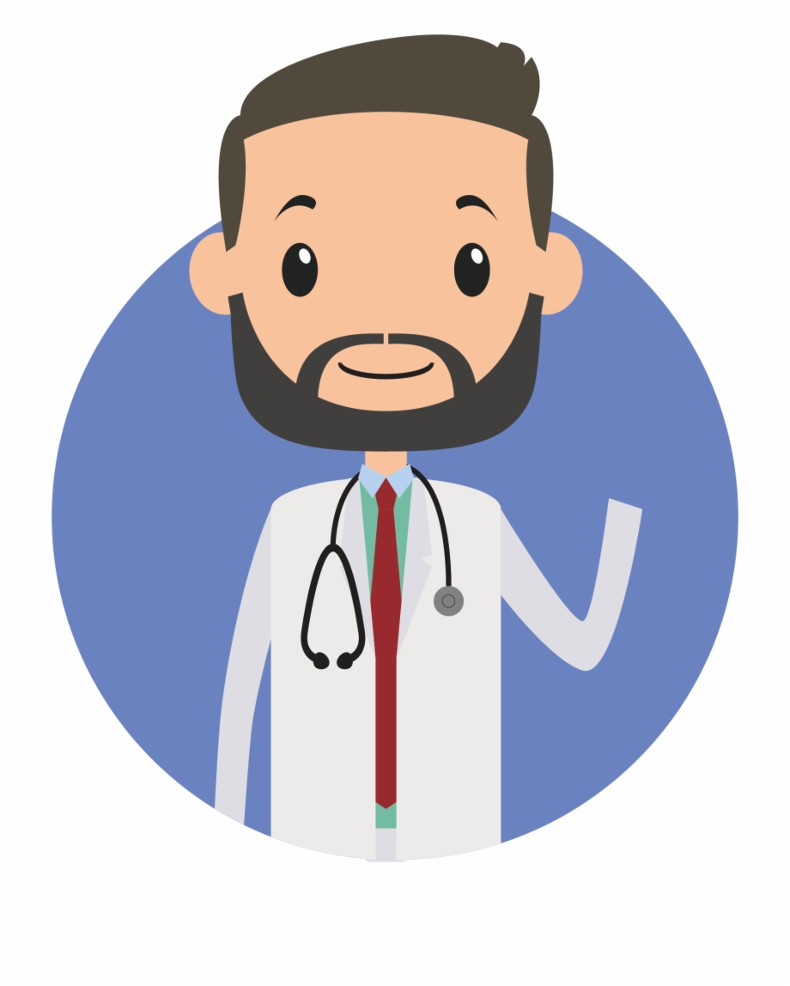
AIDOC
Prepared By :
Patel Daksh [171310132025]
Patel Jainam [171310132029]
Patel Meet [171310132034]
Patel Tirth [171310132040]
Guided by: Dr. Vijeta Khare

Slide 2
Table of Contents
Objectives
App Highlights
Tools used
Challenges and Learning
Implementation
Demo

Slide 3
Objective
In this project, we are going to develop cross platform mobile application to detect diseases using images.
Pneumonia from chest X-ray
Fracture from Bone X-ray
Diabetic retinopathy

Slide 4
APP HIGHLIGHTS
Registration (Sign Up) of User
User Sign In
Prediction of desired disease
Generation of report
Displaying Medical Articles (V2.0)
Chat-bot (V2.0)
Recommending List of Doctors in given Proximity (V2.0)

Slide 5
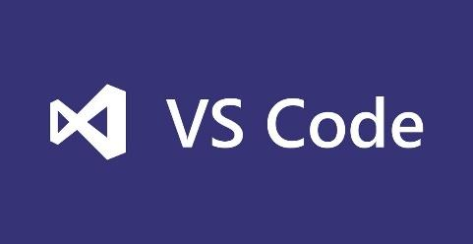
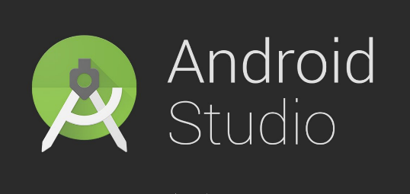


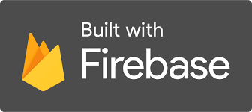
Tools

Slide 6
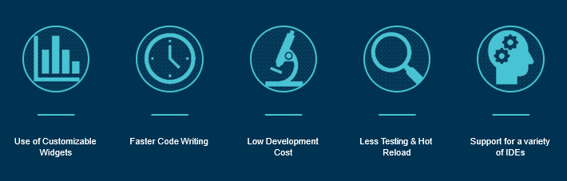
Flutter
Flutter is a high performance mobile app development tool kit that comes loaded with many impressive features like ready to use widgets, single code-base, hot reload, and many more that distinguish it from other available app development software.

Slide 7
Dart Language
Dart is a client-optimized programming language for apps on multiple platforms.
It is developed by Google and is used to build mobile, desktop, server, and web applications. Dart is an object-oriented, class-based, garbage-collected language with C-style syntax.
Dart can compile to either native code or JavaScript.

Slide 8
Google Firebase
Firebase is a fully managed platform for building iOS, Android, and web apps that provides automatic data synchronization, authentication services, messaging, file storage, analytics, and more.
Starting with Firebase is an efficient way to build or prototype mobile backend services
Advantages
1)Create Application without backend server
2)Faster than any backend web services
3)No SQL database so it is more faster
4)Auto backup
5)Authentication

Slide 9
Challenges and Learning
Application Development
Implementation of Model
Challenge 3
New Environment
Creation of cross-platform application is new work for team
Integration of Model
Most of the Deep Learning Models are based on web-application , They are not easily integrate with Application.

Slide 10
Steps Towards Solutions
Registration and Login of User using Firebase Console
Integrating CNN model to our App using Machine Teachable by Google
Report generation

Slide 11
Implementation

Slide 12
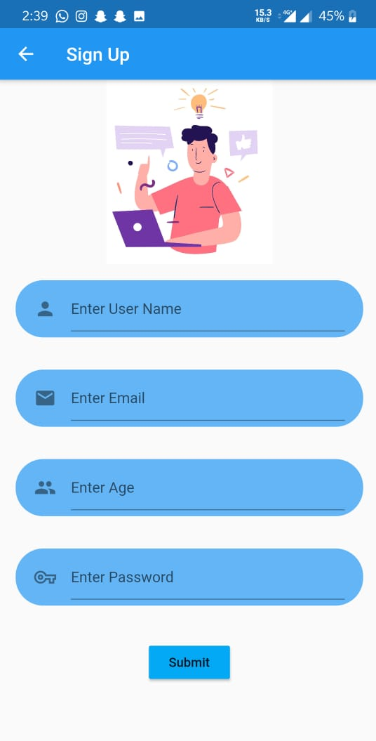
Registration
User Registers himself by providing necessary details, which are highly secured. The fields which are mandatory to provide in order to get our service is as follow:-
a). User Name
b). E-mail
c). Age
d). Password

Slide 13
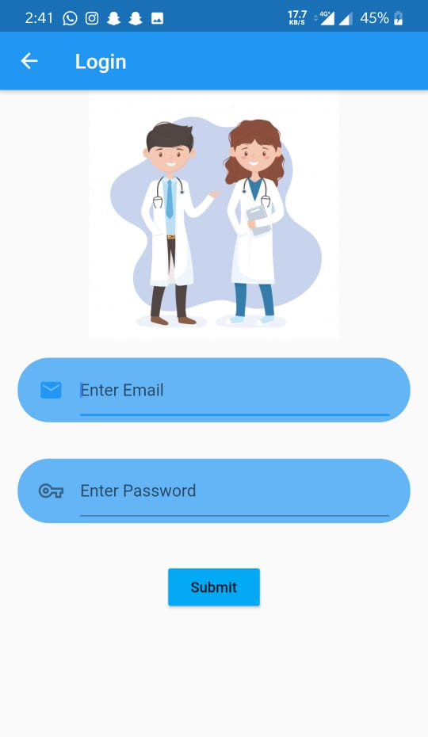
Login
User credentials are verified with firebase when user enters the details for login. If the credentials are matched, then User can login and page will be redirected to Home screen of app or else an exception will be thrown.
a). E-mail
b). Password

Slide 14
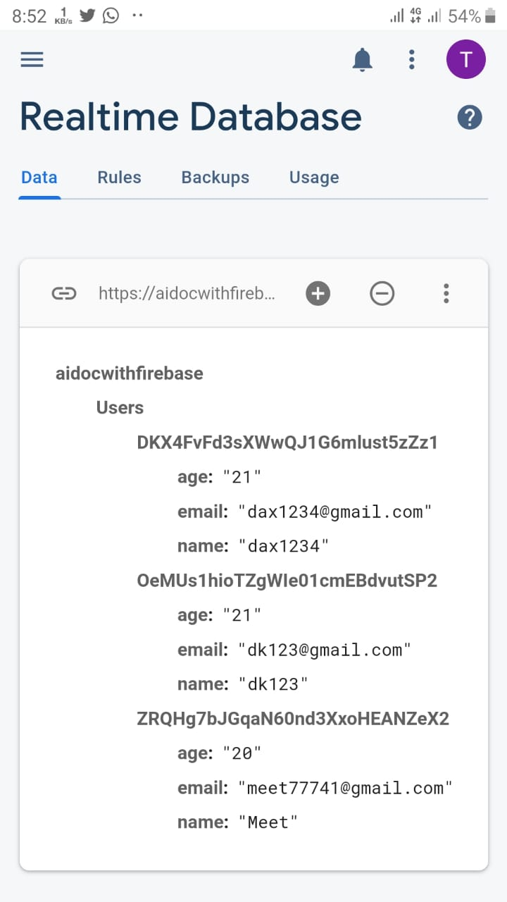
Google Firebase
After registration , user data is stored securely in the firebase.
Used for authentication of user while logging in to the app
While generating report, user data is fetched from firebase to the pdf which is stored locally in smartphone.

Slide 15
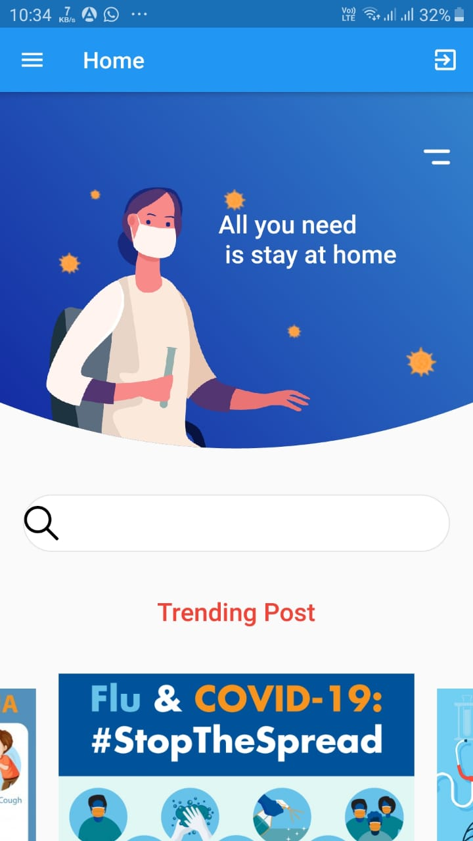
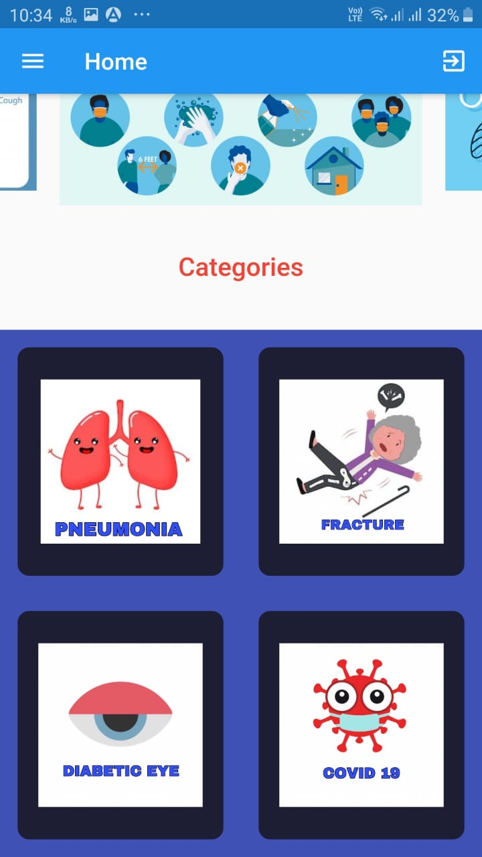
Creating UI for dashboard
Our dashboard contains an image, navigation bar, Carousel slideshow with some images, and grid view for selection of disease
For instance, we have created Carousel slideshow with images but in future it will be replaced by articles related to health.

Slide 16
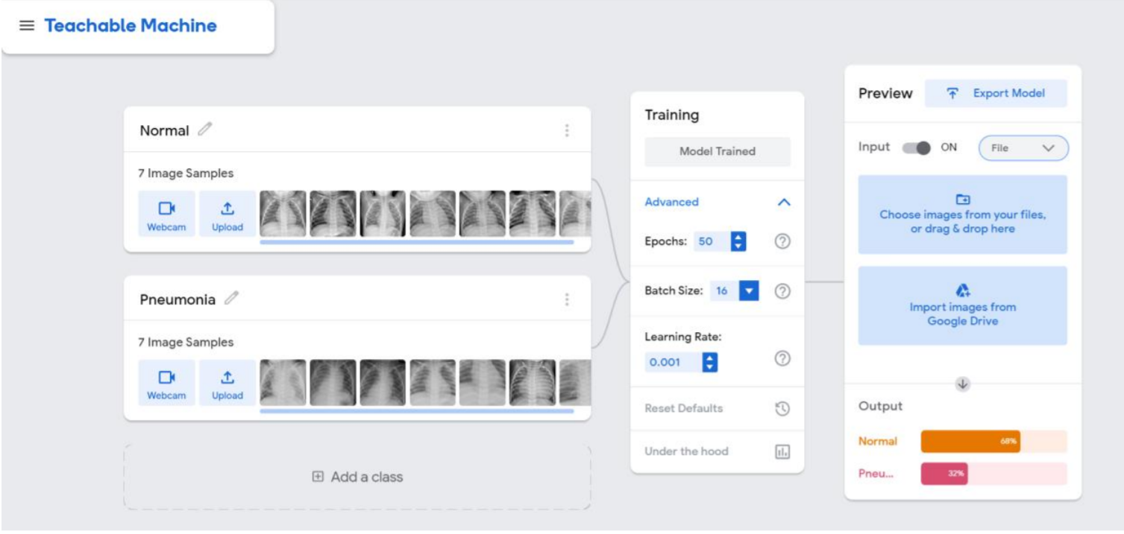
Teachable Machine Homepage

Slide 17
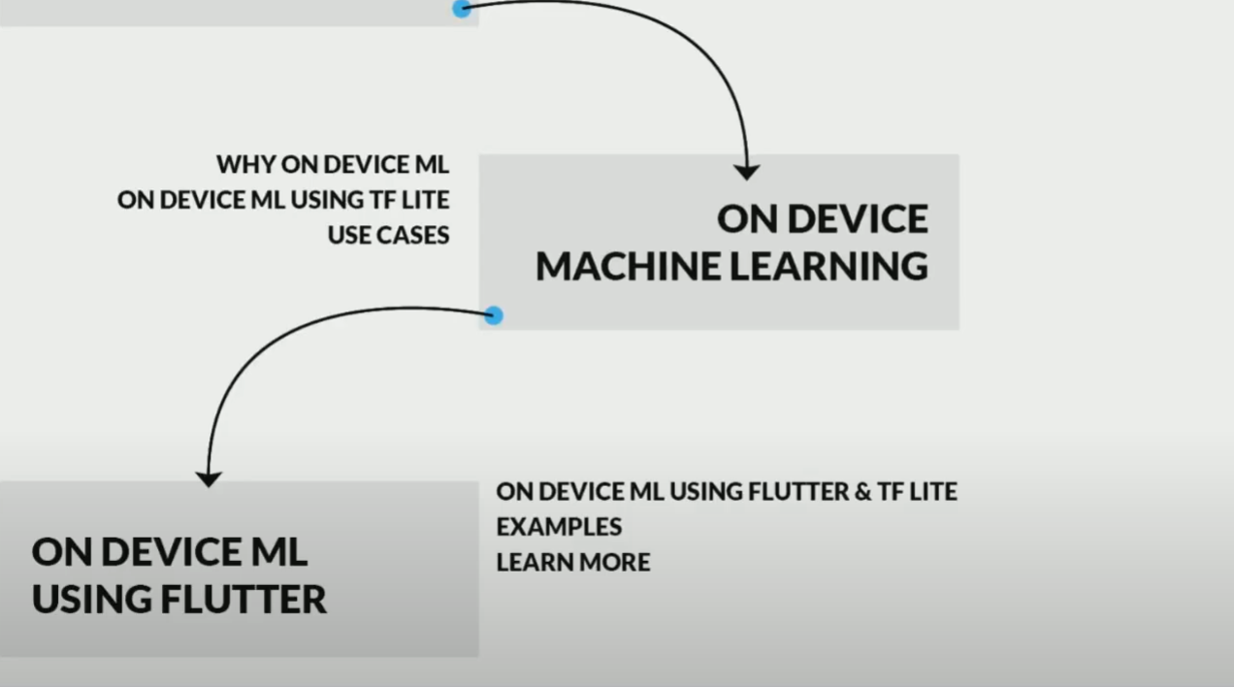

Slide 18
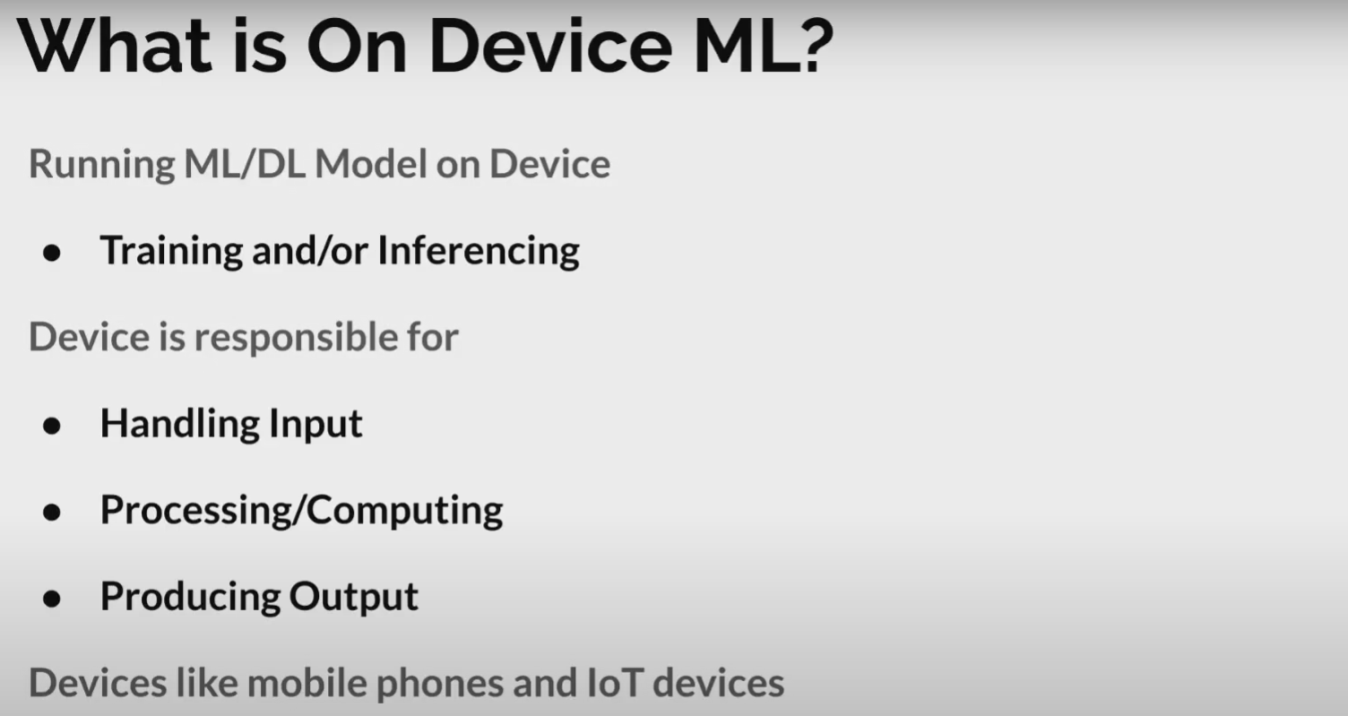

Slide 19
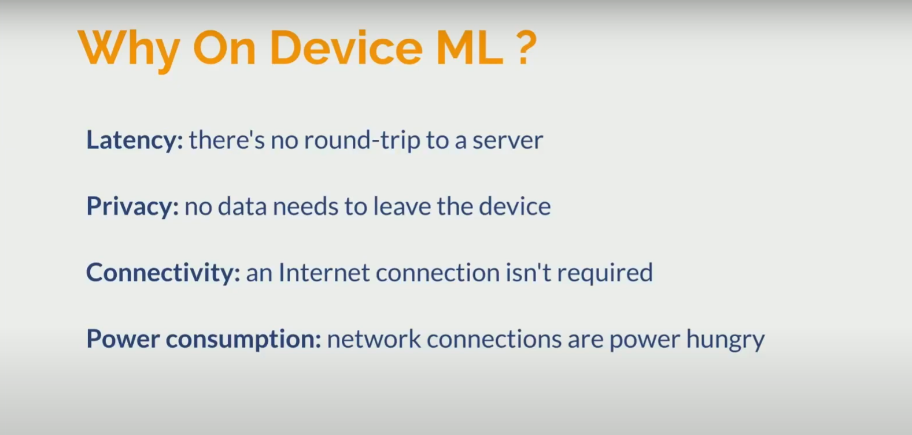

Slide 20
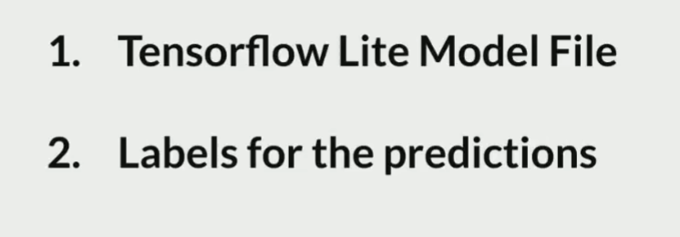
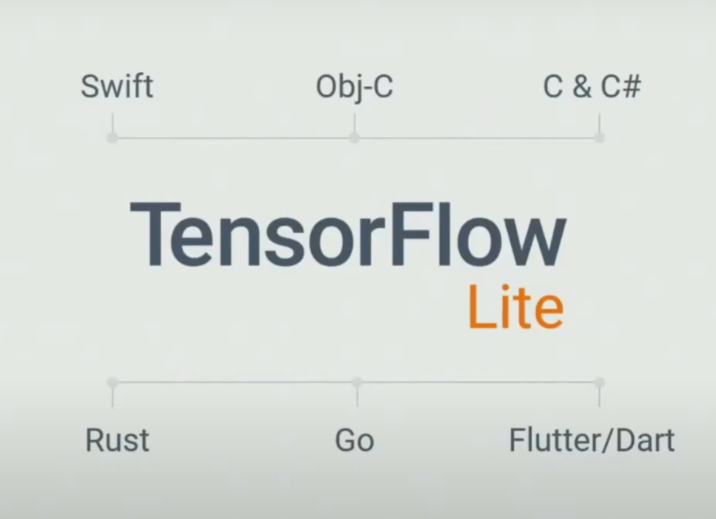
FILES REQUIRED
For making these to happen we need two important files.
TensorFlow Lite is a set of tools to help developers run TensorFlow models on mobile, embedded, and IoT devices.
It enables on-device machine learning inference with low latency and a small binary size.

Slide 21
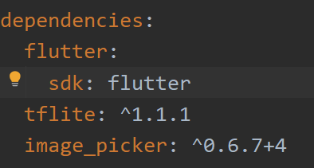
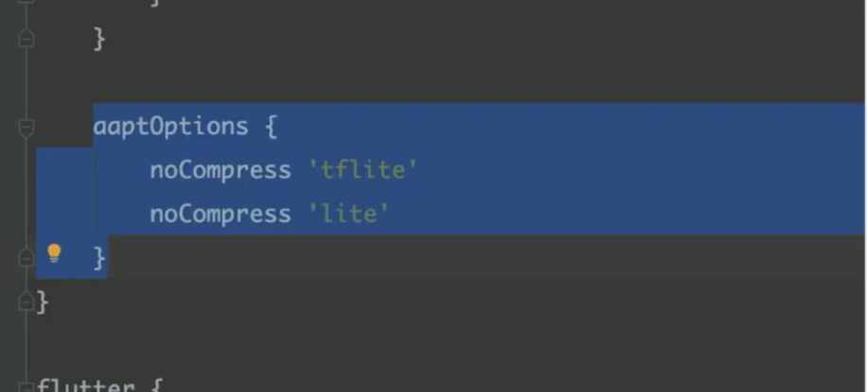
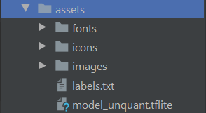
Integrating CNN model to our App using Machine Teachable by Google
pubspec.yaml
android -> app -> build.gradle

Slide 22
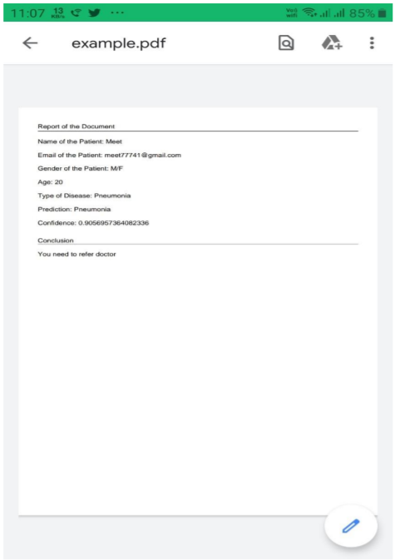
Report Generation
Once the disease is predicted, the results will be shown to user.
A user has also facility to save report to External storage of smartphone.
Report contains details like name of user, email, age, prediction of disease i.e. class, confidence.

Slide 23
Contribution
Daksh: Frontend of Registration, Login and
Jainam: Integration of DL model to application ,DL model,Data collection
Meet: Firebase and Report Generation,DL model
Tirth: Frontend for Dashboard, Validation of details

Slide 24
THANK YOU

